Slide 1

Final Assignment
SOCIAL WEB ANALYTICS
SOCIAL MEDIA SENTIMENT ANALYIS
2023 March 27
Group 4

Slide 2

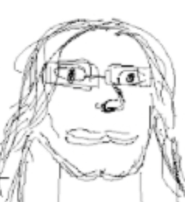
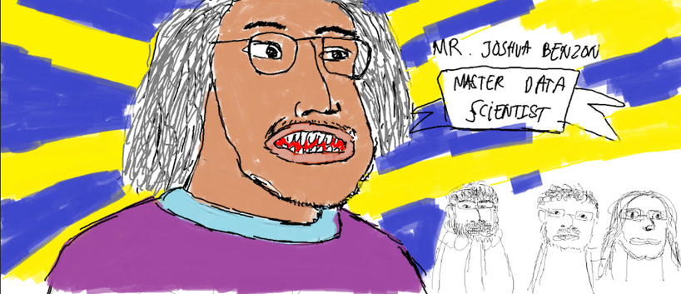


THE TEAM
Gavriel Owens Vincentio
Gargi Asthana
Joshua Benzon
Omkar Shitole
Prakhar Mishra

Slide 3



OVERVIEW
HOUSE OF THE DRAGON
RINGS OF POWER
Notes:
The purpose of this project is to analyse the sentiment of two popular TV shows, namely, 'Lord of the Rings: Rings of Power' and 'House of the Dragon' on the platform of Twitter. The methodologies used for this analysis will eventually allow us to scale up our efforts, as well as be open to more choices. We chose the aforementioned two as our first entries because both were released around the same date, as well as within the same 'Fantasy' genre.

Slide 4

Data Scraping
Data Cleaning
Collecting data off of Twitter
Preparing the data for insights
PROJECT BACKGROUND
Sentiment Analysis
Visualisation
Analysing sentiment behind each tweet
Visualising and summarising results
Notes:
Now, we will talk briefly about some of the tools and methodologies we used for this project.
This was entirely done using various modules in Python.
The whole process can be broken down into three phases:
1. Data Scraping, where we collect the data off of Twitter.
2. Data Cleaning, where we prepare the data for insights.
3. Sentiment Analysis, where we analyse the sentiment behind each tweet.
4. Visualisation, where we visualise and summarise results to draw meaningful conclusions
(points could be elaborated; needs further discussion)

Slide 5
TOOLS USED
Python libraries:
Snscrape
Pandas + re
VADER-Sentiment Analysis
Matplotlib
Notes:
For implementing our process, we are utilising the following Python libraries:
1. Sns scraping (talk about advantages against competition, qualities)
2. Pandas + re (talk about its effectiveness and cleaning data, also briefly mention re)
3. Vader/nltk (needs confirmation) (definitely talk about advantage against competitors + emoji support)
4. Visualisation tools (needs confirmation)

Slide 6
DATA SCRAPING
Notes:
Now, over to Josh to discuss more about Data Scraping in depth. (Reserve next 2-3 slides about Data Scraping?)
Talk about how sns scraping works, what makes it so effective, why are we using it, how we are implementing it, and which features are we choosing (and why) to put into the dataset with code screenshots

Slide 7

SNSCRAPE
JSON fetching using Twitter Public API
Generates new random user agents to avoid blocking
Includes cursor pagination and empty page fail safes
Allows for almost limitless scraping without reaching API limits
Can do other social media platforms as well

Slide 8
OUR METHODOLOGY
Tweet Attributes
Query Details
Datetime
Tweet ID
Username
Text
Reply Count
Retweet Count
Like Count
Quote Count
Mentions
Hashtags
Coords (if available)
Link
Timeframe: Before, During, After Release
Frequency: Monthly
Language: English

Slide 9
DATA CLEANING
Notes:
Moving on over to Omkar, who will discuss data cleaning: (reserve 2-3 slides)
Discuss how we are defining the quality of data (i.e. what qualifies as clean and unclean data), what we are leaving out and why and how, how we are prepping the data for sentiment analysis specifically etc. (with code screenshots)

Slide 10
DATA CLEANING
Libraries used for cleaning:
Pandas
re (Regular Expression)
Necessary step before feeding data to VADER for sentiment analysis
Notes on our Datasets
No missing or NaN values in the 'text' attribute
No tweet contained only @Mentions or #Hashtags

Slide 11
DATA CLEANING
Steps followed for data cleaning:
Remove Duplicates and reset index
Remove any website links
Remove the '@' symbol for mentions and '#' symbol for hashtags
Feature Splitting 'datetime' feature (yyyy-mm-dd) into distinct features - Date, Month and Year
Notes:
Question marks and exclamation marks r heuristic
Names like the twitter handles and hashtags are neutrals
If we remove it, the tweets will not make sense
and might mess up VADER

Slide 12
SENTIMENT ANALYSIS
Notes:
Now, Gargi will describe in detail how sentiment analysis is being performed on the obtained data (reserve 2-3 slides?)
Talk about why VADER, how it works and adjusted compound scores.

Slide 13
SENTIMENT ANALYSIS WITH VADER
VADER (Valence Aware Dictionary for Sentiment Reasoning)
Used for text sentiment analysis that is sensitive to both polarity (positive/negative) and intensity (strength) of emotion.
Uses human-centric approach using qualitative analysis and empirical validation.
Originally all words have a score between -4 to 4. But the score returned is always between -1 and 1.
Analyzes takes into consideration texts, lexical features and emoticons/emojis as well.
Notes:
VADER (Valence Aware Dictionary for sEntiment Reasoning) is a model used for text sentiment analysis that is sensitive to both polarity (positive/negative) and intensity (strength) of emotion. Introduced in 2014, VADER text sentiment analysis uses a human-centric approach, combining qualitative analysis and empirical validation by using human raters and the wisdom of the crowd.
VADER sentiment analysis (well, in the Python implementation anyway) returns a sentiment score in the range -1 to 1, from most negative to most positive.
The sentiment score of a sentence is calculated by summing up the sentiment scores of each VADER-dictionary-listed word in the sentence.
Originally all words have a score between -4 to 4. But the score returned is always between -1 and 1. This is achieved by normalisation.

Slide 14
THE 5 HEURISTICS
Punctuations
Capitalization
If the score is positive, VADER adds a certain empirically-obtained quantity for every exclamation point (0.292) and question mark (0.18). If the score is negative, VADER subtracts.
VADER takes this into account by incrementing or decrementing the sentiment score of the word by 0.733, depending on whether the word is positive or negative, respectively.
Amazing
great work
Amazing!!!
GREAT work
Notes:
1. Punctuations - VADER sentiment analysis takes this into account by amplifying the sentiment score of the sentence proportional to the number of exclamation points and question marks ending the sentence. VADER first computes the sentiment score of the sentence. If the score is positive, VADER adds a certain empirically-obtained quantity for every exclamation point (0.292) and question mark (0.18). If the score is negative, VADER subtracts.
2. Capitalization - “AMAZING performance.” is definitely more intense than “amazing performance.” And so VADER takes this into account by incrementing or decrementing the sentiment score of the word by 0.733, depending on whether the word is positive or negative, respectively.

Slide 15
Degree Modifiers
Shift in Polarity using “but”
VADER maintains a booster dictionary which contains a set of boosters and dampeners.
all sentiment-bearing words before the “but” have their valence reduced to 50% of their values, while those after the “but” increase to 150% of their values.
kind of painful
very painful
we appreciate your efforts but,
the results are not acceptable.
Tri-gram
Negation is captured by multiplying the sentiment score of the sentiment-laden lexical feature by an empirically-determined value -0.74
not good work
not bad work
Notes:
3. The third heuristic is the use of degree modifiers. Take for example “effing cute” and “sort of cute”. VADER maintains a booster dictionary which contains a set of boosters and dampeners.
4. Shift in Polarity using “but” - VADER implements a “but” checker. Basically, all sentiment-bearing words before the “but” have their valence reduced to 50% of their values, while those after the “but” increase to 150% of their values.
5. Examining the tri-gram
Here, a tri-gram refers to a set of three lexical features. VADER maintains a list of negator words. Negation is captured by multiplying the sentiment score of the sentiment-laden lexical feature by an empirically-determined value -0.74

Slide 16
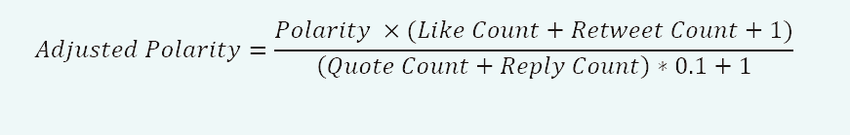
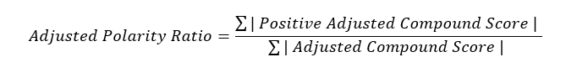
ADJUSTING POLARITY SCORES
Polarity scores have been adjusted by the given formula below by attaching weights to the engagement.
Polarity is directly proportional to like and retweet counts whereas inversely proportional to quote and reply counts (controversial reaction).

Slide 17
RESULTS
Notes:
Finally, Owens will be going through the results obtained from the analysis, and what we can take away from them:
(As many slides as needed for all screenshots)
- Talk about data visualisation, tools
- Explain each screenshot in detail

Slide 18
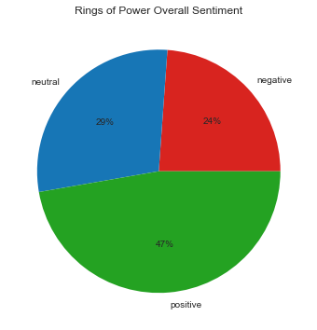
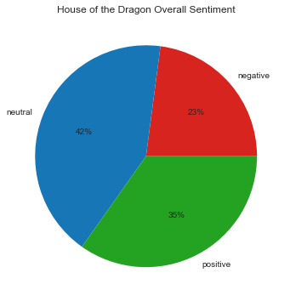
Overall Sentiment Ratio of Both Shows

Slide 19
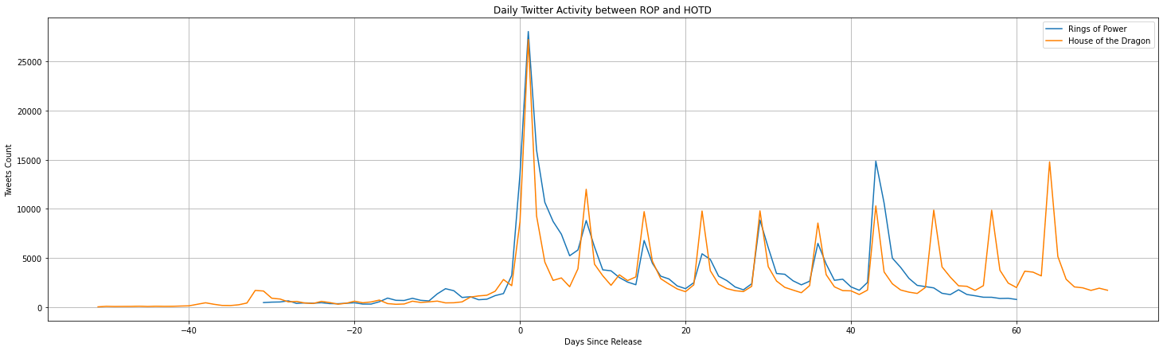
Twitter Activity (Counts) between Rings of Power and House of the Dragon

Slide 20
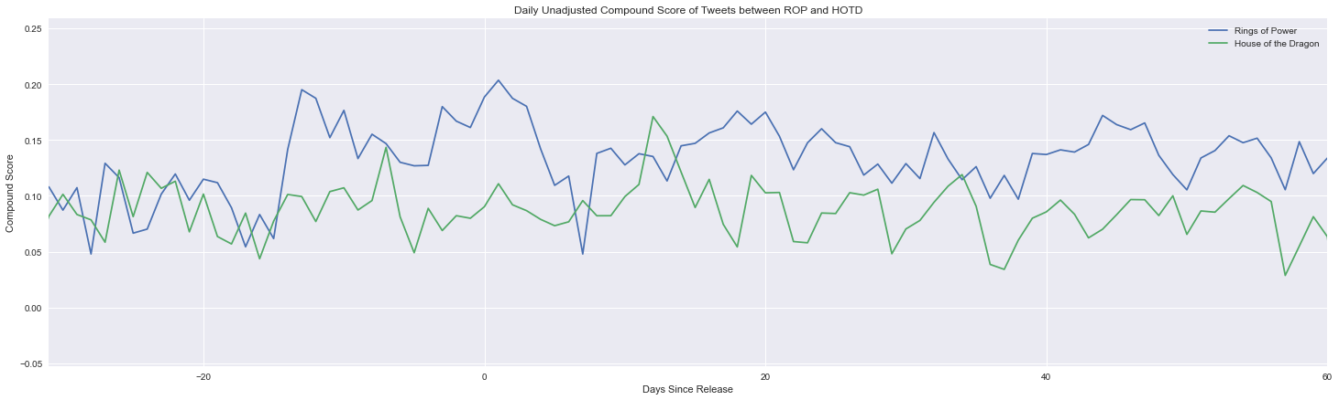
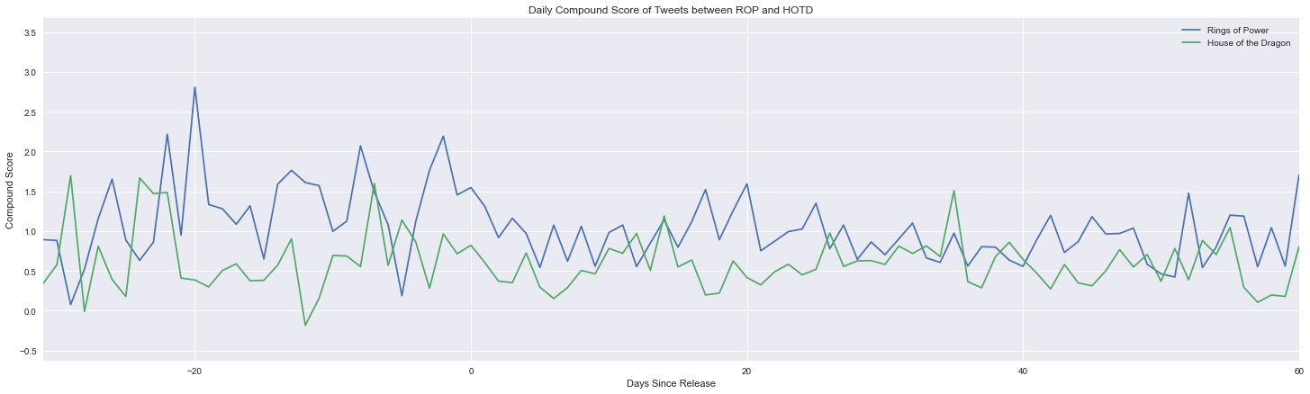
Before and After Adjustment of the Compound Score

Slide 21
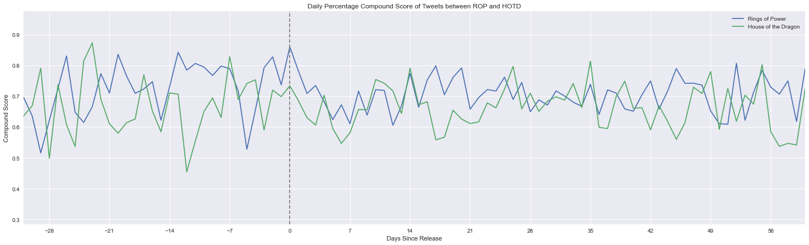
Positive Ratio of the Compound Score

Slide 22
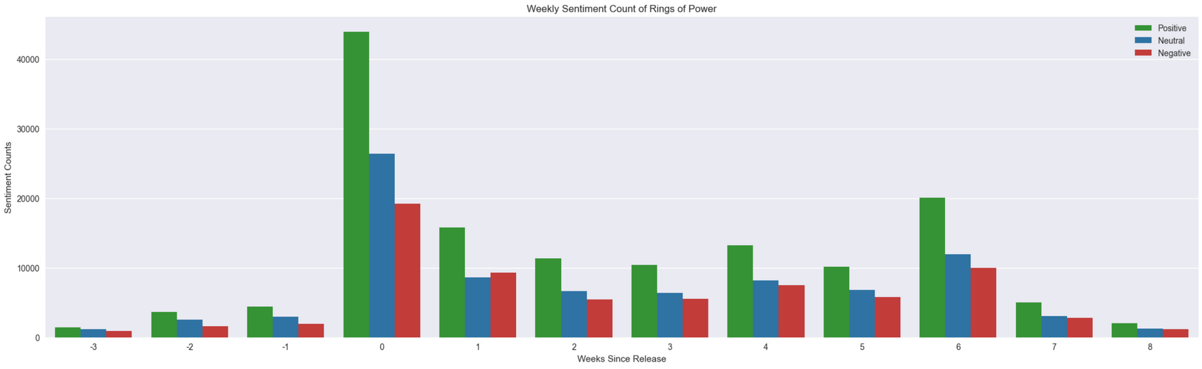
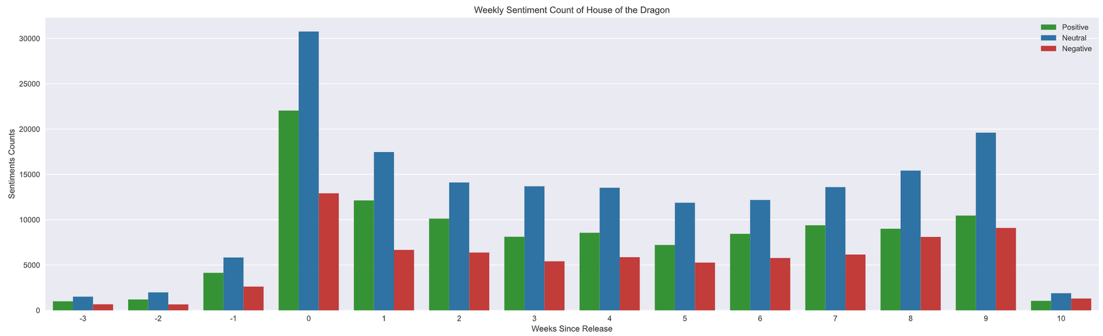
Weekly Sentiment Counts of Both Shows

Slide 23
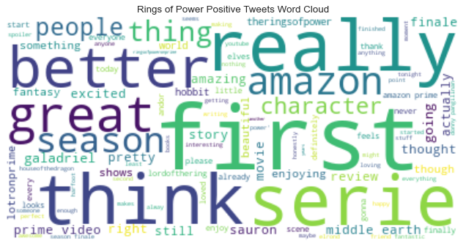
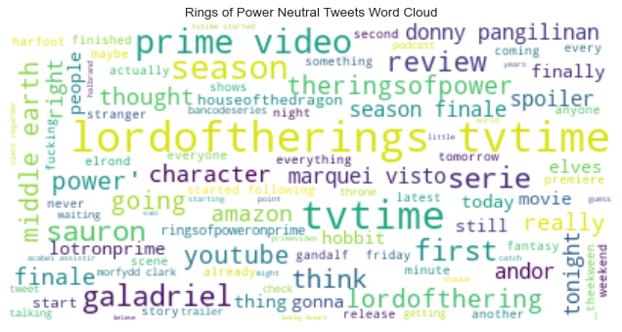
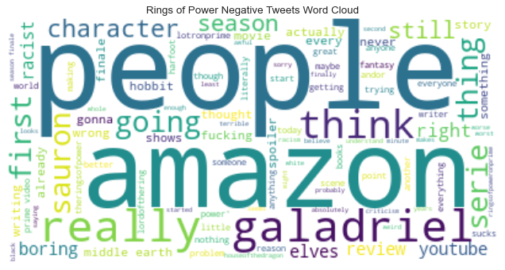
Word Cloud of Rings of Power
+
~
-

Slide 24
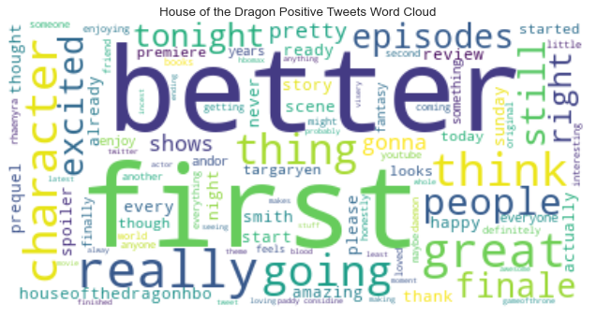
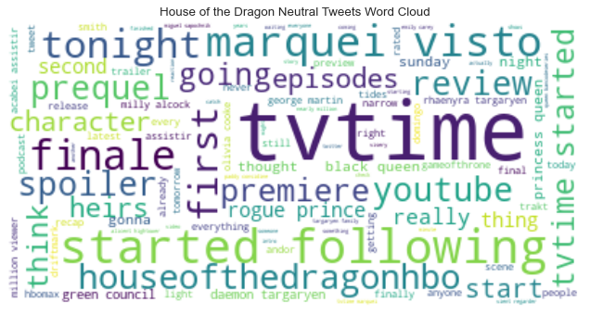
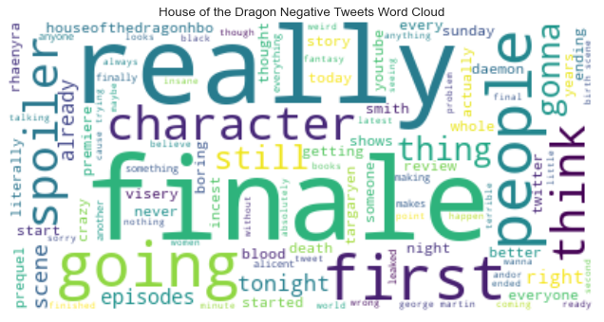
Word Cloud of House of the Dragon
+
~
-

Slide 25
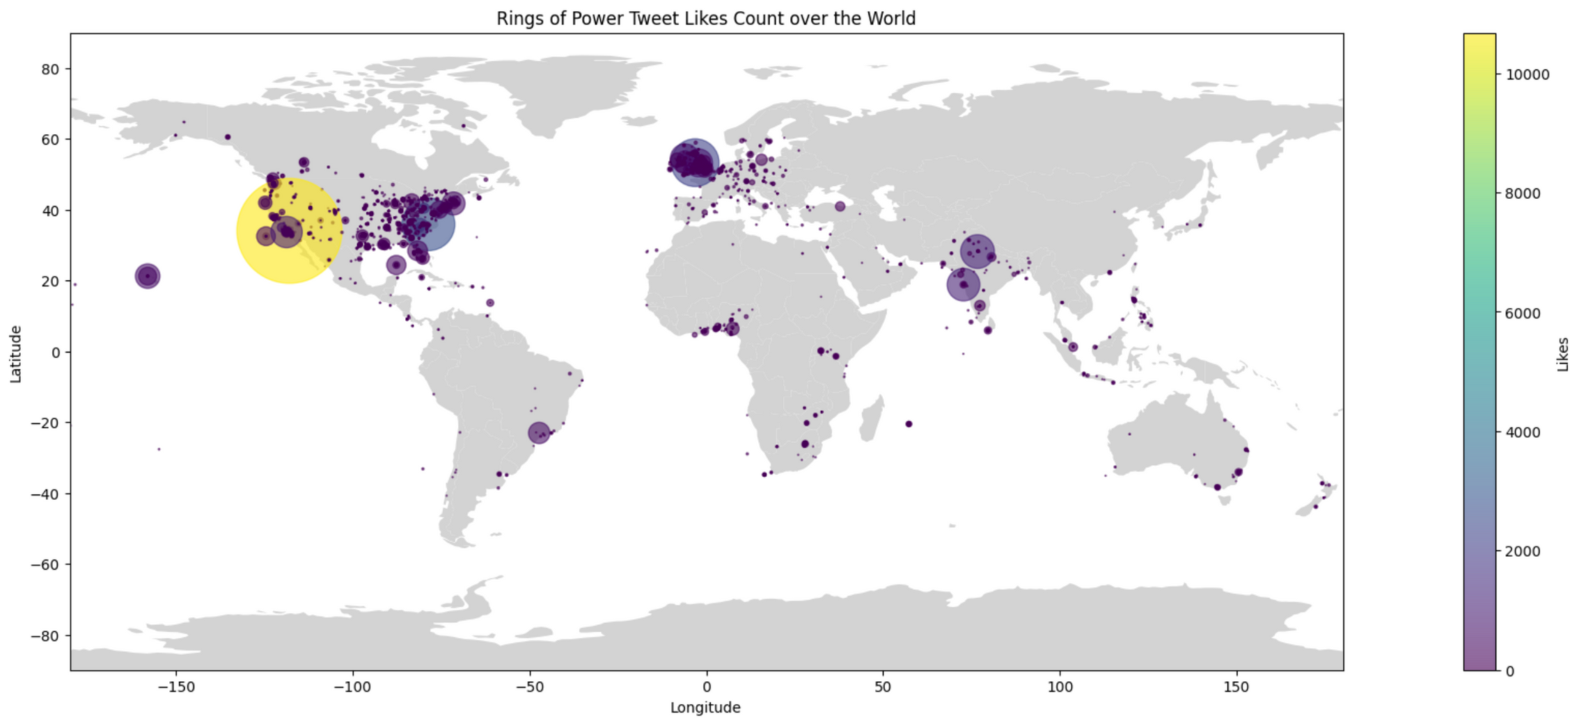
World Map of Tweet Likes Count of Rings of Power

Slide 26
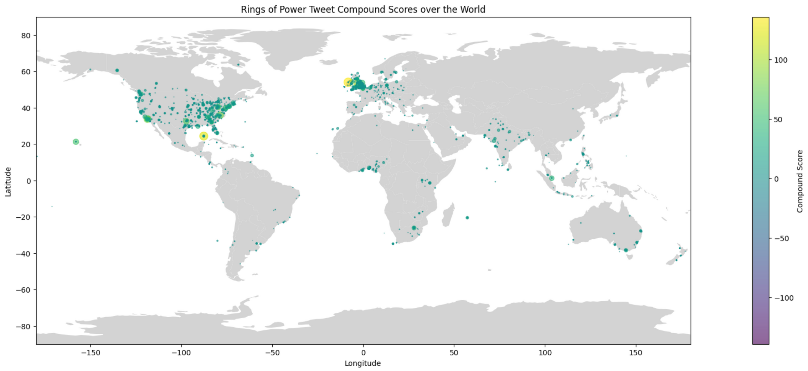
World Map of Tweet Compound Scores of Rings of Power
Notes:
yellow parts are yucatan, mexico and ireland

Slide 27
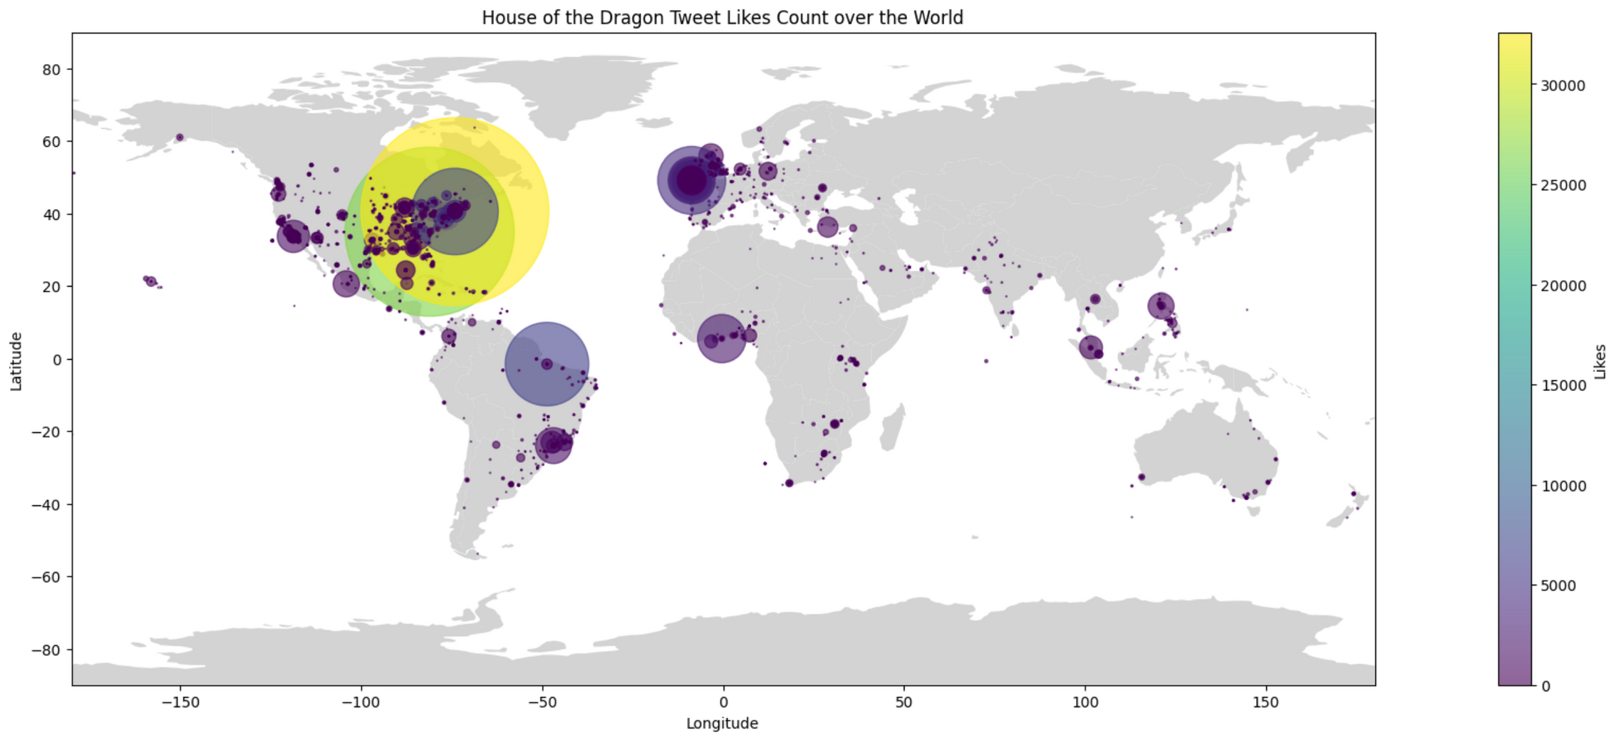
World Map of Tweet Likes Count of House of the Dragon

Slide 28
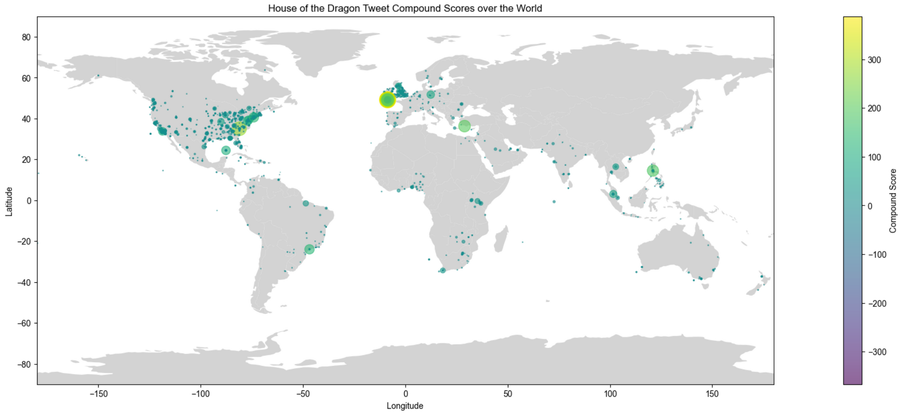
World Map of Tweet Compound Scores of House of the Dragon
Notes:
yellow point is southern UK

Slide 29
CONCLUSION

Slide 30
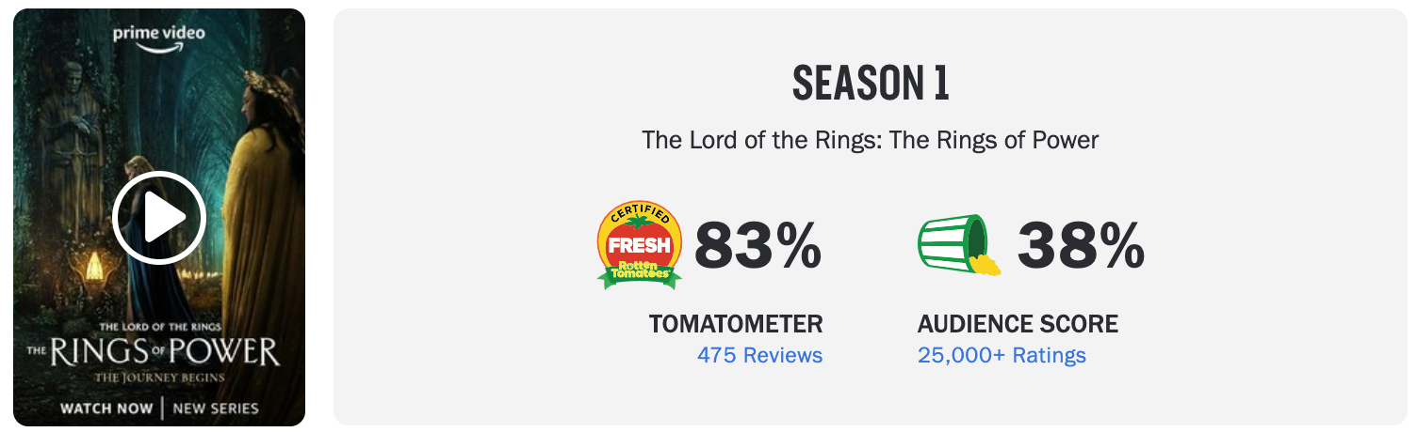
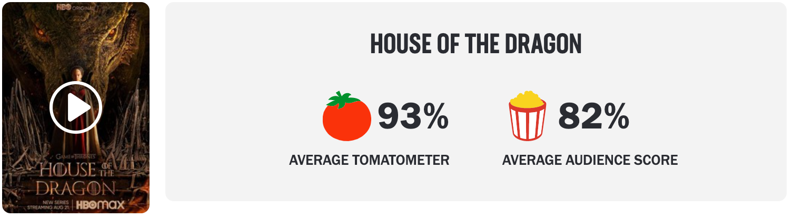
Rotten Tomatoes Scores

Slide 31
RINGS OF POWER'S OLDER CRITICAL AUDIENCE
HOUSE OF THE DRAGON'S WIDER AUDIENCE
Since Rings of Power comes from an older franchise, older fans might be more critical. These older fans may also not be on Twitter, as Twitter skews younger.
As seen in the Twitter Activity graphs, House of the Dragon was consistently more discussed than Rings of Power, aside from RoP's finale.
WHAT MIGHT
THIS MEAN?
RINGS OF POWER'S SMALLER, MORE PASSIONATE FANBASE
AMERICAN EAST VS WEST COASTS
Despite Rings of Power's smaller audience on Twitter, it seems to trend more positively. This might mean that RoP has a strong, niche fanbase.
An odd discovery: Rings of Power tweets from the west coast (California, etc.) are significantly more liked than the east coast. House of the Dragon is more liked on the east coast than the west coast.
6

Slide 32
Final Assignment
THANK YOU
2023 March 27
Group 4

